Slide 1




PDS
Computer Vision
Kubernetes Orchestration docker container implementation
https://github.com/siagianp
Open TofU-IaC
https://www.youtube.com/@AmelOline/videos
https://github.com/amelcharolinesgn2/Cloud-Infrastructures
https://github.com/amelcharolinesgn2/ClouD-Infrastructure-SISKA-2025
https://github.com/amelcharolinesgn2/CCNA-1-v7
https://github.com/amelcharolinesgn2/CCNA-2-v7
https://github.com/amelcharolinesgn2/CCNA-3-v7
https://github.com/amelcharolinesgn2/CCNA-4-v7
https://github.com/amelcharolinesgn2/ANJAR_CCNP_Lab
https://github.com/amelcharolinesgn2/CloudSim
https://github.com/amelcharolinesgn2/AWS Certificate
https://github.com/amelcharolinesgn2/OpenStack
https://github.com/amelcharolinesgn2/IoT_simulator-mqtt-NodeRed
Notes:
https://roadmap.sh/aws
https://roadmap.sh/aws
https://aws.amazon.com/what-is-cloud-computing/
https://www.ibm.com/think/topics/cloud-computing
3. https://www.ibm.com/topics/cloud-computing
4. https://csrc.nist.gov/pubs/sp/800/145/final
https://csrc.nist.gov/pubs/sp/800/145/final
https://docs.openstack.org/liberty/install-guide-rdo/overview.html

Slide 2
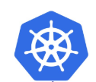
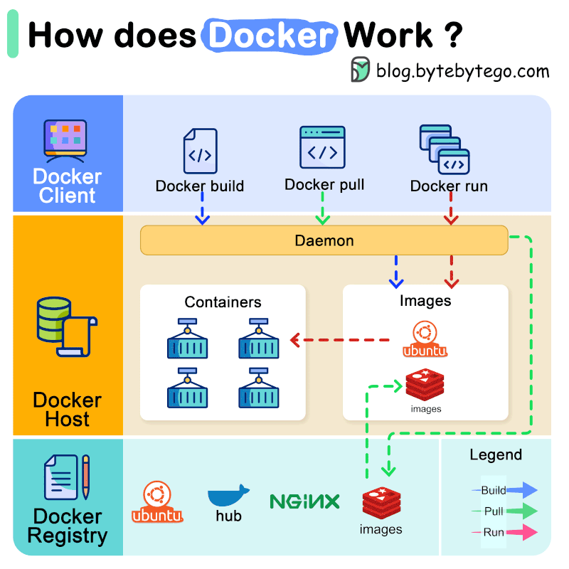
Docker Work ?
Kubernites Work ?
Notes:
https://www.youtube.com/watch?v=Cs2j-Rjqg94

Slide 3
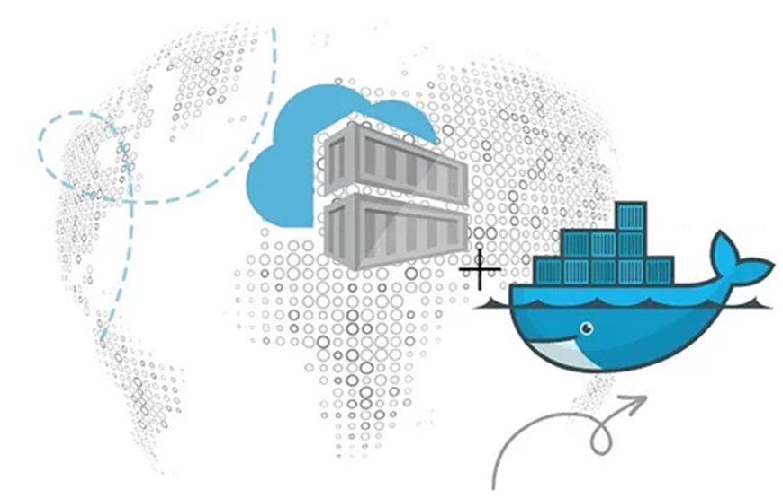
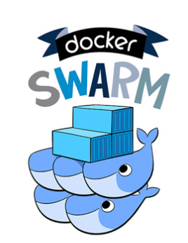
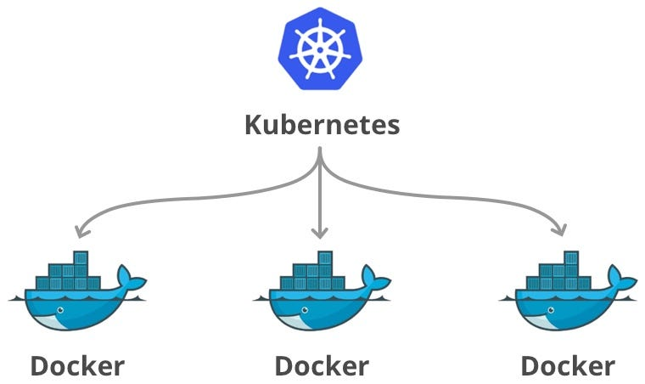
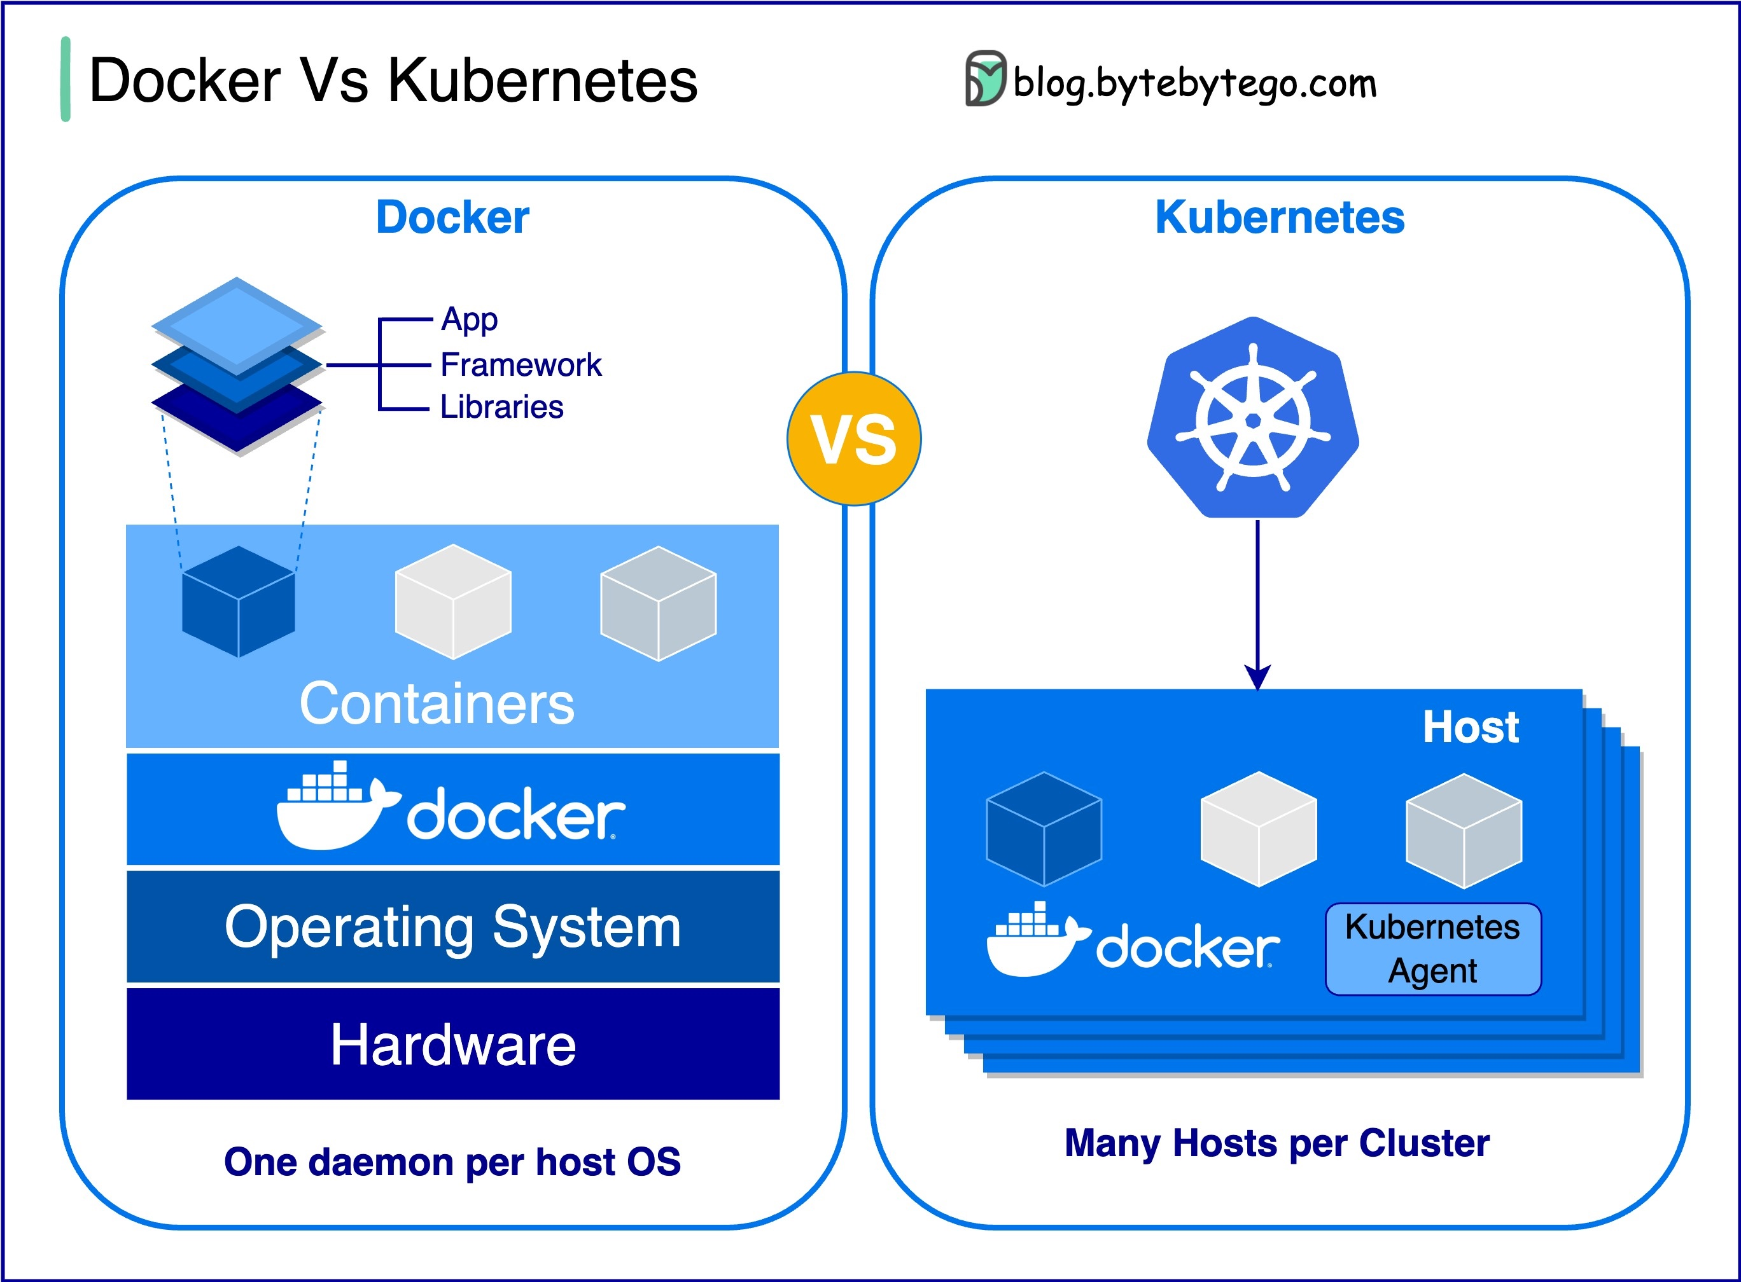
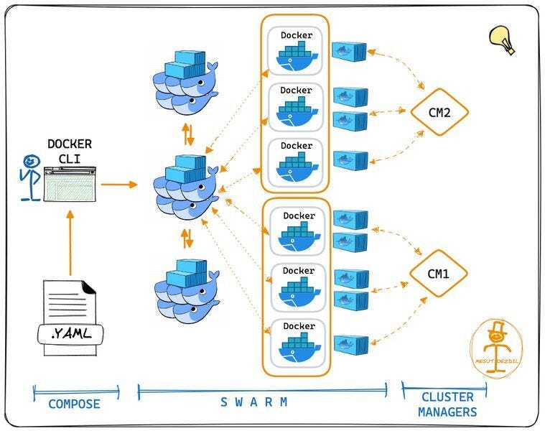
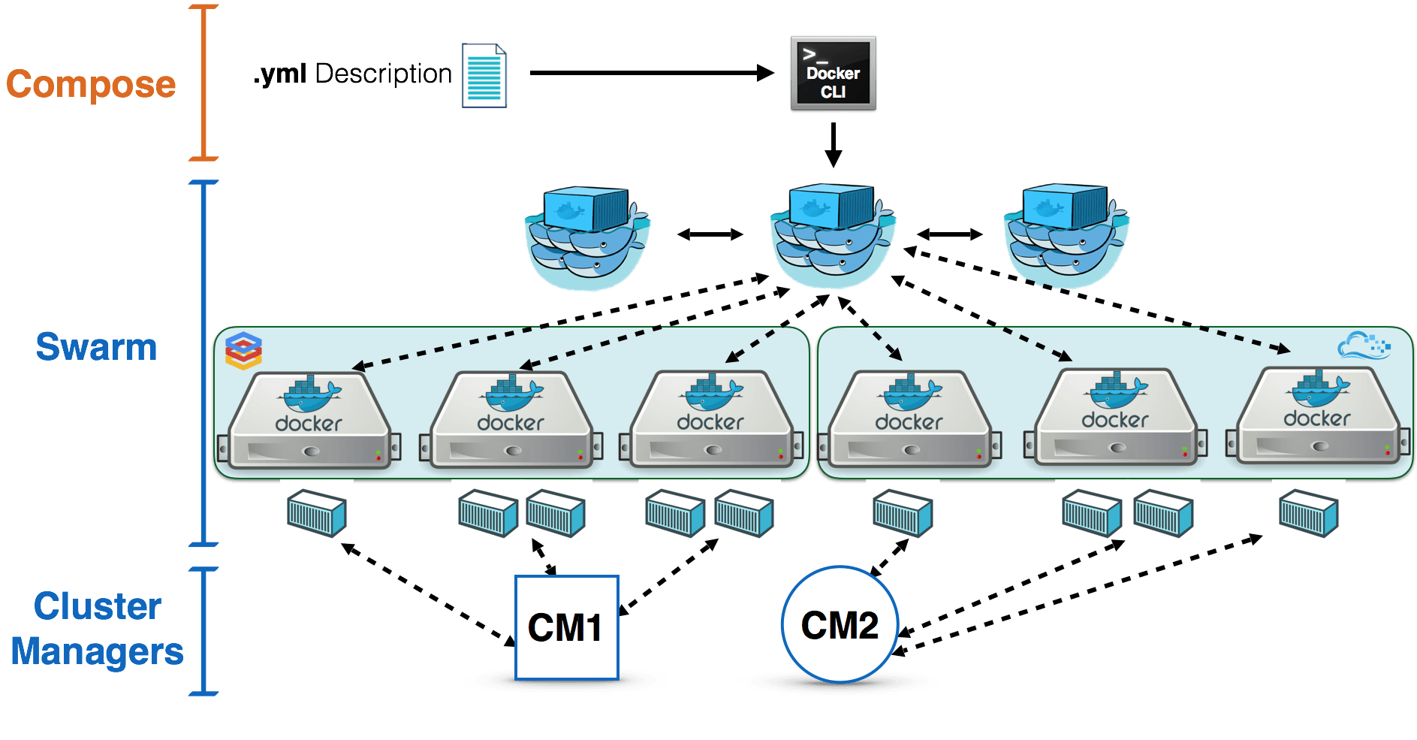
Notes:
https://devopscube.com/docker-container-clustering-tools/
https://events19.linuxfoundation.org/wp-content/uploads/2017/11/Tutorial-A-First-Tutorial-on-Container-Orchestration-Wyn-B.-Van-Devanter-_-Vic-Kumar-Excella.pdf

Slide 4
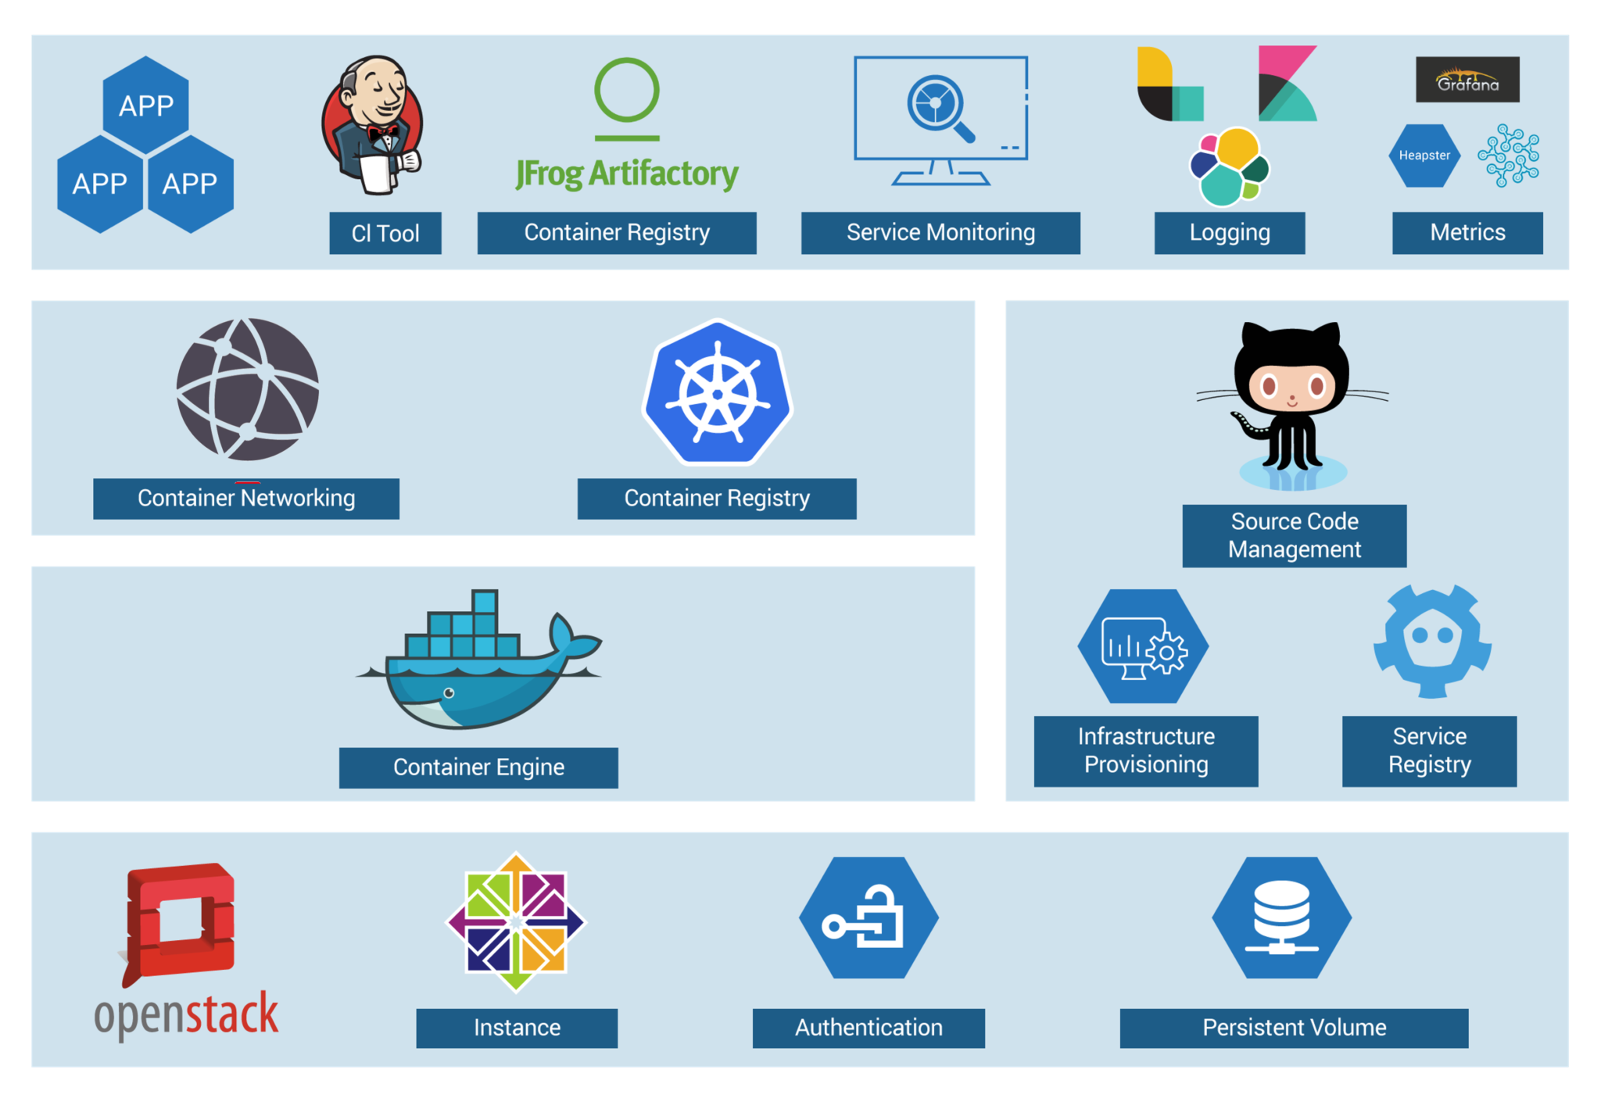
Kubernetes: Orchestrating Containers

Slide 5
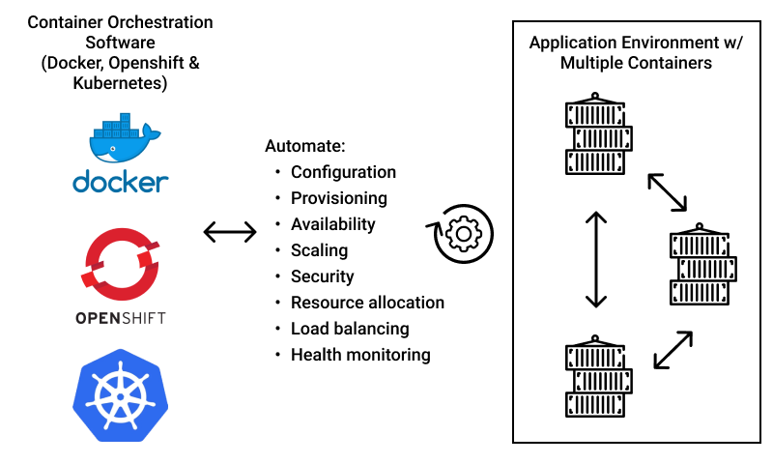
Kubernetes: Orchestrating Containers

Slide 6
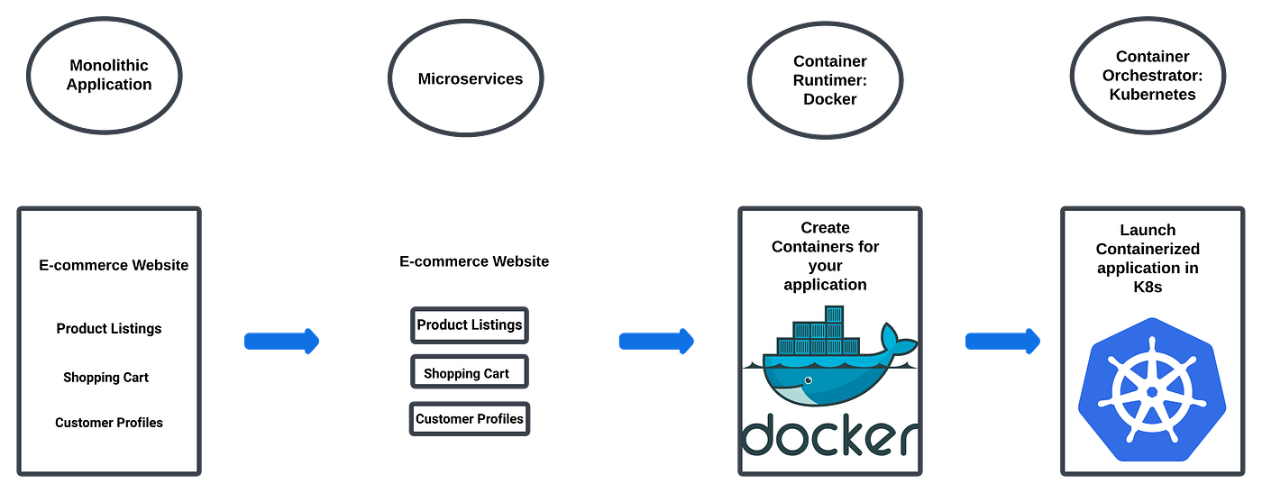
Kubernetes: Orchestrating Containers

Slide 7
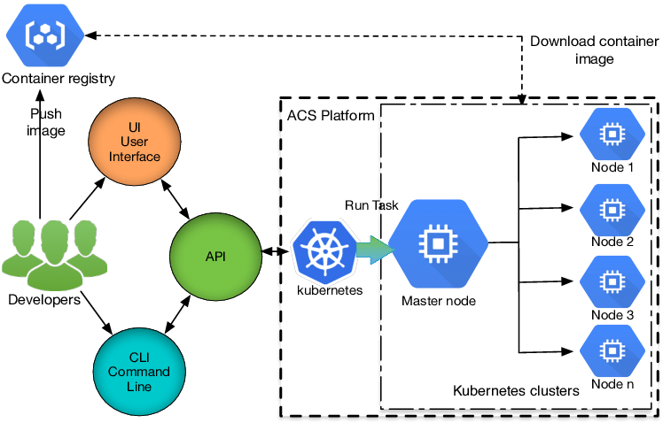
Kubernetes orchestration

Slide 8
Features of Kubernetes
Kubernetes Architecture?
Compute scheduling considering resource needs of containers and find right place and run them automatically.
Self-healing in nature so if container crashes a new one will be created to replace it.
Horizontal scaling can be achieved by observing CPU and memory metrics , add and remove instances as required.
Volume management is easy as it manages the persistent storage used by applications.
IP address , DNS and multiple instances load balancing.
During upgrade health of new instances is monitored and if failure occurs rollback happens to previous version automatically.
Management of application configuration and secrets.

Slide 9
Use Cases
Kubernetes Architecture?
Large scale application deployments
Management of microservices
CI/CD software development
Server less computing
Hybrid and multi-cloud deployments
Big data processing
Computation
Machine learning

Slide 10
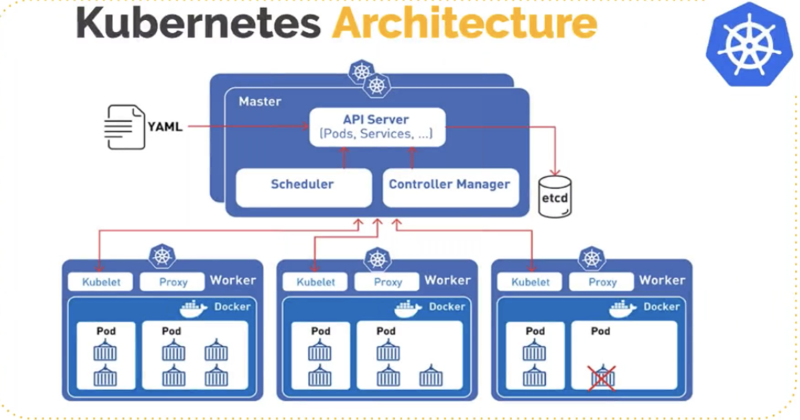
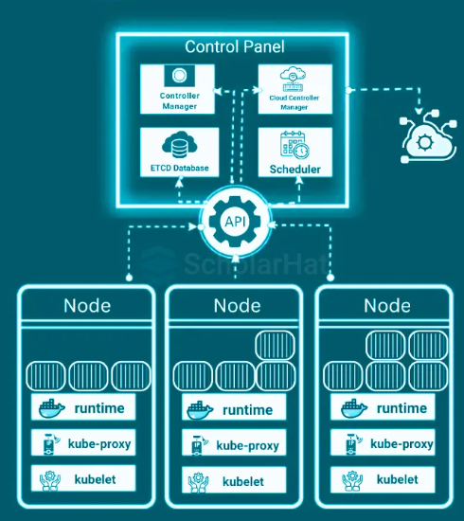
Kubernetes Architecture?
Kubernetes Architecture and Installation
Notes:
https://cloudwithease.com/what-is-kubernetes/
The Control Plane
Kubectl
It is a command line tool used to interact with the Kubernetes cluster. The control plane consists of API server, the etcd metadata store, Scheduler, Controller manager and cloud controller manager.
API Server
The Kube API Server is REST server which exposes Kubernetes APIs to the external world. We can have multiple instances of API server in the control plane for high availability. API server cluster state is kept in etcd.
etcd Store
The complete cluster is stored in etcd (https://coreos.com/etcd/) , which is a consistent, reliable and distributed key value store. The etcd store is an open-source object developed by CoreOS initially. For redundancy 3 to 5 instances are maintained if you lose data in etcd store you lose your cluster also.
Scheduler
Kube-scheduler is responsible for scheduling Pods to worker nodes. Implementation of sophisticated scheduling algorithms takes a lot of information into account such as availability of resources on each node, constraints mentioned by user, type of available nodes, resource limits and quotas, and other factors such as affinity , anti-affinity, tolerations and taints.
Controller Manager
The Kube controller manager is a single process which has multiple controllers to achieve simplicity. These controllers keep a watch on changes and respond accordingly
Node controllers are responsible for notice and respond when a node goes down
Replication controller ensure there is correct number of pods for each replica set or objects for replication controller
Endpoints controller assign for each service an endpoint object which lists the service pods
Service account and token controllers initialize new namespaces with default service account and corresponding API access tokens
The Data Plane
The data plane comprises nodes in the cluster which run containerized workloads or pods. The data plane and control plane share physical and logical machines. In order to communicate to nodes Kubernetes installs several components on each node, watch, schedule pods etc
Kubelet
The Kubelet is Kubernetes agent and responsible for talking to API servers and running and managing pods on the node. Kubelet is responsible for :
Download pod secrets from API server
Volume mounts
Pod container running via container runtime interface (CRI)
Report status of each Pod and node
Probe container liveness
Kube Proxy
Networking aspects are handled by this component for the node. It operates as local front for services and forwards TCP and UDP packets and discovers IP addresses of services via DNS or environment variables
Container Runtime
Kubernetes runs containers and supports a variety of container runtimes. Docker is supported initially. Kubernetes runs containers via an interface known as CRI which is based on gRPC.

Slide 11
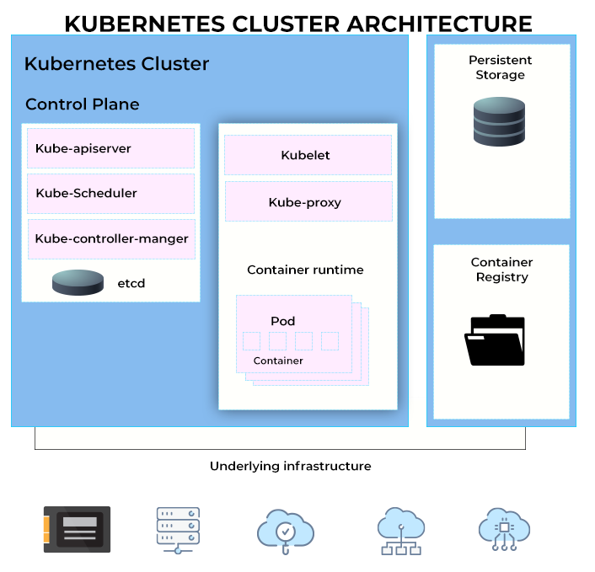
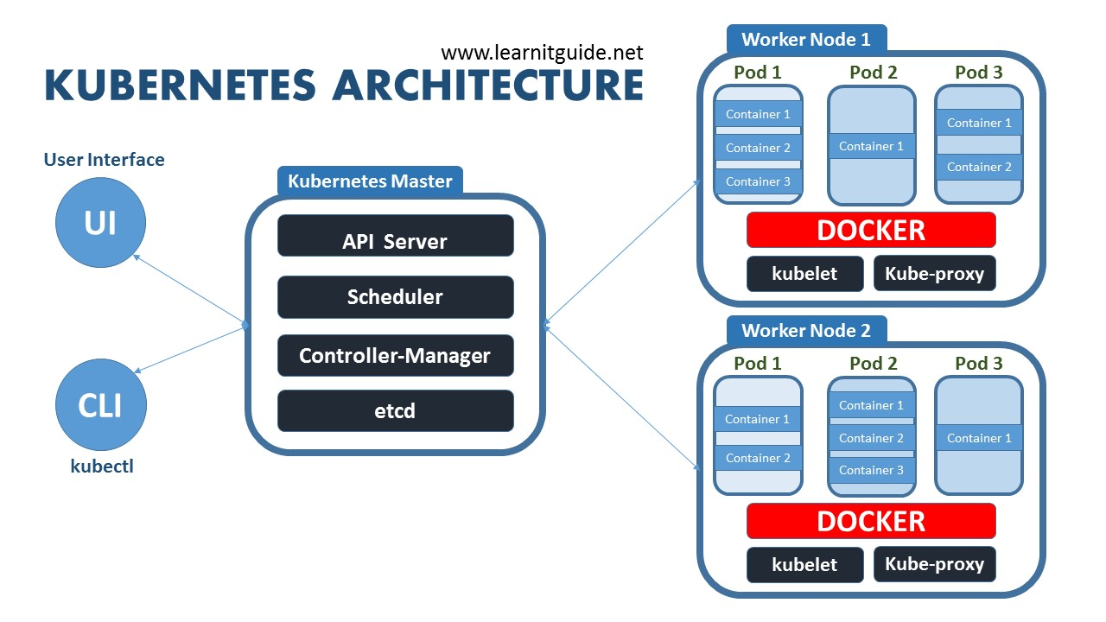
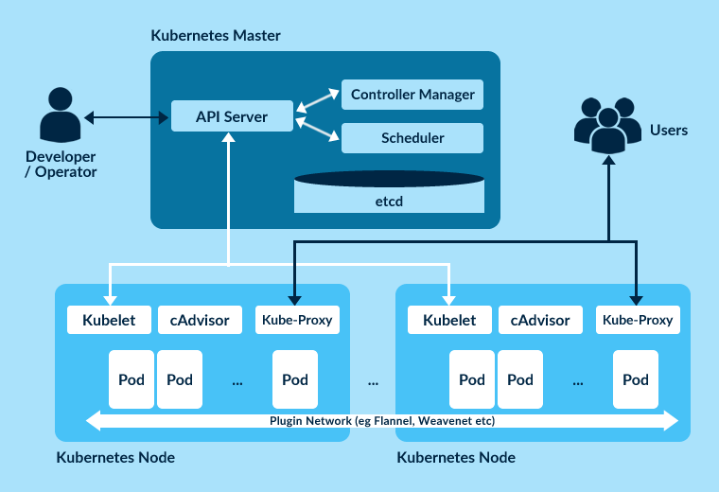
Kubernetes Architecture?

Slide 12
Kubernetes Architecture?
Kubernetes provides you with:
Service discovery and load balancing Kubernetes can expose a container using the DNS name or using their own IP address. If traffic to a container is high, Kubernetes is able to load balance and distribute the network traffic so that the deployment is stable.
Storage orchestration Kubernetes allows you to automatically mount a storage system of your choice, such as local storages, public cloud providers, and more.
Automated rollouts and rollbacks You can describe the desired state for your deployed containers using Kubernetes, and it can change the actual state to the desired state at a controlled rate. For example, you can automate Kubernetes to create new containers for your deployment, remove existing containers and adopt all their resources to the new container.
Automatic bin packing You provide Kubernetes with a cluster of nodes that it can use to run containerized tasks. You tell Kubernetes how much CPU and memory (RAM) each container needs. Kubernetes can fit containers onto your nodes to make the best use of your resources.
Self-healing Kubernetes restarts containers that fail, replaces containers, kills containers that don't respond to your user-defined health check, and doesn't advertise them to clients until they are ready to serve.
Secret and configuration management Kubernetes lets you store and manage sensitive information, such as passwords, OAuth tokens, and SSH keys. You can deploy and update secrets and application configuration without rebuilding your container images, and without exposing secrets in your stack configuration.
Batch execution In addition to services, Kubernetes can manage your batch and CI workloads, replacing containers that fail, if desired.
Horizontal scaling Scale your application up and down with a simple command, with a UI, or automatically based on CPU usage.
IPv4/IPv6 dual-stack Allocation of IPv4 and IPv6 addresses to Pods and Services
Designed for extensibility Add features to your Kubernetes cluster without changing upstream source code
Notes:
https://github.com/jpetazzo/container.training

Slide 13
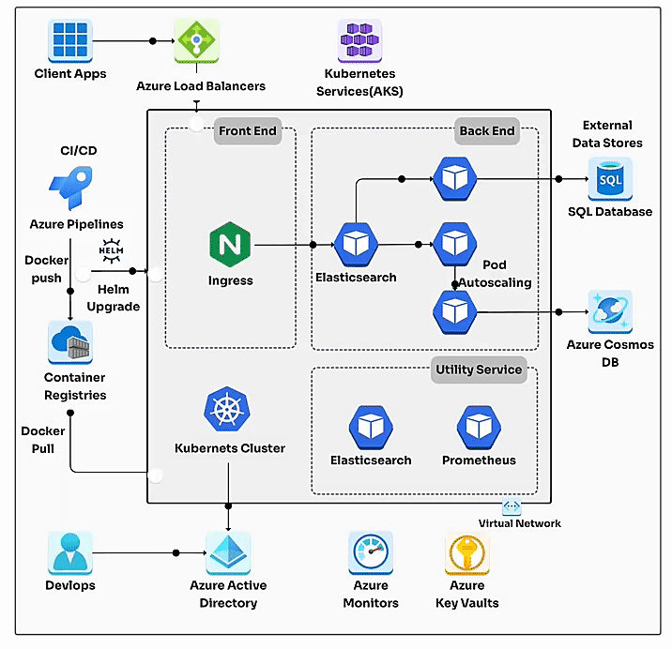
Kubernetes Architecture Diagram
Kubernetes Architecture Diagram for Microservices
Azure
Notes:
https://cloudairy.com/blog/understanding-kubernetes-architecture-diagrams-and-components/

Slide 14
Kubernetes Architecture Diagram

Slide 15
Understanding Kubernetes architecture diagrams and components
Notes:
https://cloudairy.com/blog/understanding-kubernetes-architecture-diagrams-and-components/#section-6

Slide 16
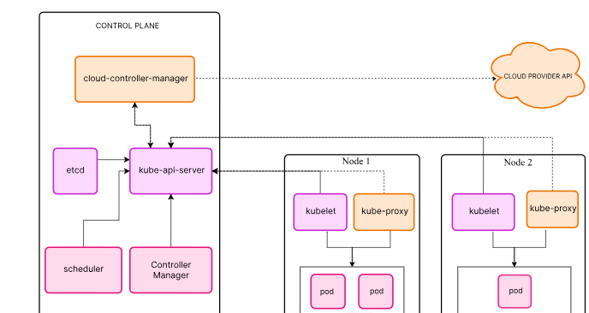
Kubernetes Architecture Diagram
Notes:
https://cloudairy.com/blog/understanding-kubernetes-architecture-diagrams-and-components/
Introduction
What is Kubernetes?
What is Kubernetes Architecture?
Kubernetes Architecture Components: Worker Nodes
Kubernetes Cluster Add-on Components
Top Kubernetes Tools

Slide 17
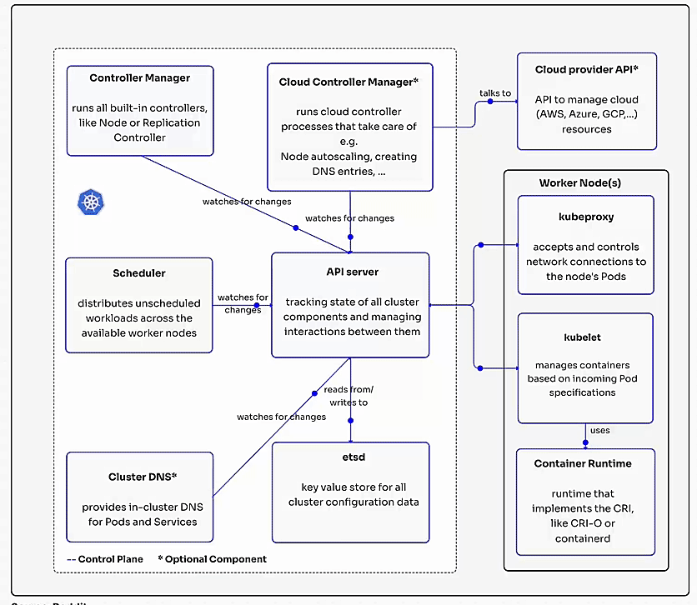
Kubernetes Architecture Diagram
Understanding Kubernetes architecture enables you to grasp its vital elements and fine-tune them for effective operations. Kubernetes empowers automation capabilities, streamlining the management and deployment of applications. However, to achieve efficient container orchestration, it is vital to utilize the appropriate tools and techniques to ensure a better return on investment.
Notes:
https://cloudairy.com/blog/understanding-kubernetes-architecture-diagrams-and-components/
What is Kubernetes Architecture?
Kubernetes, a powerful open-source container orchestration platform, has revolutionized the way organizations manage and deploy containerized applications. At its core, Kubernetes provides a robust framework for automating the deployment, scaling, and management of containerized workloads.
Understanding the Architecture
Kubernetes architecture follows a master-worker model, where the control plane oversees and manages the cluster, while the worker nodes execute the actual containerized applications.
Kubernetes Architecture Components: Control Plane
The control plane is the brain of the Kubernetes cluster, responsible for orchestrating and managing various components. It consists of several key elements:
1. kube-apiserver:
The central communication hub that handles API requests and manages the cluster's state.
Acts as the gateway for users and other components to interact with the cluster.
Validates API requests authenticates and authorizes users, and coordinates processes between the control plane and worker nodes.
Uses etcd to store and retrieve cluster state information.
2. etcd:
A highly available, distributed key-value store that stores critical information about the cluster's configuration and state.
Used by the kube-apiserver to store and retrieve data about pods, services, deployments, and other Kubernetes objects.
Ensures consistency and reliability of the cluster state.
3. kube-scheduler:
Responsible for assigning pods to worker nodes based on resource requirements, constraints, and scheduling policies.
Uses information stored in etcd to make scheduling decisions.
Considers factors like node capacity, affinity rules, and anti-affinity rules.
4. kube-controller-manager:
Manages various controllers that are responsible for specific tasks within the cluster.
Includes controllers for replication sets, deployments, stateful sets, daemon sets, and jobs.
Ensures that the desired state of the cluster is maintained by creating, updating, and deleting pods as needed.
5. cloud-controller-manager (Optional):
Integrates Kubernetes with cloud providers for cloud-specific features.
Provides APIs for interacting with cloud resources, such as virtual machines, load balancers, and storage volumes.
Simplifies the management of Kubernetes clusters in cloud environments.
Kubernetes Architecture Components: Worker Nodes
Worker nodes are the essential components of a Kubernetes cluster where the actual containerized applications are executed. They are responsible for running pods, which are the smallest unit of deployment in Kubernetes and can contain one or more containers.
Key Components of Worker Nodes:
kubelet:
The agent that runs on each worker node and acts as the interface between the node and the control plane.
Responsible for registering the node with the control plane, managing pods on the node, and communicating with the kube-apiserver.
Handles tasks such as creating, starting, stopping, and deleting containers, as well as managing volumes and network interfaces.
kube-proxy:
Responsible for service discovery and load balancing within the cluster.
Creates network rules to route traffic to pods based on service definitions.
Ensures that services are accessible from both inside and outside the cluster.
Container Runtime:
The engine that runs containers on the worker node.
Examples of popular container runtimes include Docker, containerd, and CRI-O.
Responsible for pulling container images, creating and managing containers, and providing resources to containers.
How Worker Nodes Work:
The control plane schedules pods to be executed on worker nodes based on various factors, such as resource requirements and constraints.
The kubelet on the worker node receives the pod specification and creates the necessary containers using the container runtime.
The kube-proxy ensures that services are exposed to the outside world and that traffic is load-balanced across multiple instances of a service.
The worker nodes provide the underlying infrastructure and resources for running containerized applications.
Kubernetes Cluster Add-on Components
Add-on components are optional components that can be added to a Kubernetes cluster to enhance its functionality and meet specific requirements. These components often provide specialized services or features that are not included in the core Kubernetes distribution.
Importance of Add-on Components:
Enhanced functionality: Add-on components can provide additional features and capabilities, such as network management, DNS resolution, and resource monitoring.
Customization: You can choose the add-on components that best suit your specific needs and use cases.
Integration: Many add-on components integrate seamlessly with Kubernetes, making it easy to incorporate them into your cluster.
Popular Add-on Components:
CNI Plugin: A Container Network Interface (CNI) plugin is used to provide network connectivity for containers within a Kubernetes cluster. Popular CNI plugins include Calico, Flannel, and Weave Net.
CoreDNS: A DNS server that provides DNS resolution for services within a Kubernetes cluster.
Metrics Server: A tool that collects and exposes resource usage metrics for Kubernetes clusters, allowing you to monitor and optimize resource allocation.
Web UI: A web-based user interface for managing Kubernetes clusters, providing a more user-friendly way to interact with the platform.
Top Kubernetes Tools
Kubernetes offers a powerful platform for managing containerized applications, but mastering its functionalities requires a robust set of tools. Here's a breakdown of some essential tools categorized by their purpose:
1. Kubernetes CLI Tools:
These command-line tools provide a powerful way to interact with your Kubernetes cluster directly.
kubectl: The swiss army knife of Kubernetes tools. It allows you to perform a wide range of tasks, including managing deployments, pods, services, and namespaces.
Helm: A package manager for Kubernetes that simplifies the deployment and management of applications. Helm charts provide a standardized way to package and install applications in Kubernetes clusters.
Skaffold: A development tool that streamlines the local development and testing of containerized applications. It automates building, pushing, and deploying images to Kubernetes clusters.
Customize: A tool for customizing Kubernetes manifests and deployments. It simplifies applying changes to multiple resources without modifying the original configuration files.
Kubeval: A tool for validating Kubernetes YAML files before deployment. It helps ensure that your configurations are syntactically correct and adhere to best practices.
2. Kubernetes Monitoring Tools:
Effective monitoring is crucial for maintaining healthy and performant Kubernetes clusters. These tools provide insights into resource utilization, application health, and overall cluster performance.
Sematext Monitoring: A comprehensive monitoring solution that offers detailed insights into Kubernetes clusters, including resource usage, application performance, and infrastructure metrics.
Kubernetes Dashboard: A simple web-based UI for viewing and managing your Kubernetes cluster. It provides an overview of resources, deployments, and pod health.
Prometheus: A popular open-source monitoring system that collects and stores metrics from containerized applications and Kubernetes resources.
Grafana: A visualization tool that allows you to create custom dashboards for visualizing metrics collected by Prometheus and other monitoring tools.
Jaeger: A distributed tracing platform that helps you understand the flow of requests through your microservices applications. Jaeger can be integrated with Kubernetes to monitor the performance and health of your containerized services.
3. Kubernetes Security Tools:
Security is paramount for any containerized environment. These tools help you harden your Kubernetes cluster and identify potential security vulnerabilities.
Open Policy Agent (OPA): A powerful policy engine that allows you to enforce security policies at various levels within your Kubernetes cluster.
KubeLinter: A tool that analyzes Kubernetes YAML files for security best practices and potential vulnerabilities.
Kube-bench: A tool that performs security audits of your Kubernetes cluster configuration. It identifies potential security risks and suggests remediation steps.
Kube-hunter: A security tool that scans for vulnerabilities in Kubernetes clusters by identifying unauthorized deployments, privileged containers, and misconfigurations.
Terrascan: A tool used for infrastructure security scanning. It can be integrated with Kubernetes to scan your cluster configuration for security risks.
4. Kubernetes Deployment Tools:
These tools automate the build, test, and deployment process for your containerized applications, enabling you to streamline your CI/CD (continuous integration/continuous delivery) pipelines.
Jenkins: A popular open-source CI/CD tool that can be used to automate the build, test, and deployment of containerized applications to Kubernetes clusters.
Spinnaker: A powerful CI/CD platform that offers continuous delivery features for deploying containerized applications to Kubernetes.
Fluxcd.io: A GitOps tool that uses Git as the source of truth for managing deployments in Kubernetes. It automates the deployment of applications based on changes made to Git repositories.
Choosing the Right Tools
The selection of the best tools depends on your specific needs and use case. Consider factors like the size and complexity of your cluster, your monitoring and security requirements, and your preferred CI/CD pipeline structure. By leveraging the right combination of tools, you can effectively manage your Kubernetes environment, optimize performance, and ensure the reliability and security of your containerized applications.
Kubernetes Architecture Best Practices
Kubernetes, as a powerful container orchestration platform, provides numerous features and functionalities to manage containerized applications effectively. To optimize your Kubernetes deployments and ensure maximum performance, reliability, and security, it's essential to adhere to best practices.
1. Utilizing Namespaces:
Logical Isolation: Namespaces offer a way to logically divide your cluster into distinct environments or projects.
Resource Management: They help manage resources more efficiently by isolating different teams or applications.
Security: Namespaces can be used to implement role-based access control (RBAC) and restrict access to specific resources.
2. Implementing Readiness and Liveness Probes:
Health Checks: Readiness probes check if a pod is ready to receive traffic, while liveness probes ensure the container is still running and healthy.
Automatic Restart: Kubernetes can automatically restart pods that fail liveness probes or are not ready to receive traffic.
3. Setting Resource Requests and Limits:
Resource Allocation: Define the minimum and maximum resources (CPU and memory) that a pod requires.
Preventing Overutilization: Setting limits helps prevent pods from consuming excessive resources and impacting other applications.
Quality of Service: Guaranteeing a certain level of performance for critical applications.
4. Leveraging High-Level Deployment Objects:
Abstractions: Use higher-level deployment objects like Deployments, ReplicaSets, StatefulSets, and DaemonSets to simplify application management.
Declarative Configuration: Describe the desired state of your application, and Kubernetes will automatically reconcile the actual state to match the desired one.
Rolling Updates: Easily update applications without downtime using features like rolling updates.
5. Distributing Workloads Across Multiple Nodes:
Availability: Spread pods across multiple nodes to improve fault tolerance and availability.
Load Balancing: Distribute traffic evenly across pods to prevent overloading individual nodes.
Resource Optimization: Ensure efficient utilization of resources across the cluster.
6. Implementing Role-Based Access Control (RBAC):
Security: Restrict access to resources based on user roles and permissions.
Granular Control: Grant specific permissions to different users or groups, preventing unauthorized access.
Compliance: Ensure compliance with security regulations and best practices.
7. Considering Cloud Services for External Hosting:
Managed Kubernetes: Utilize cloud-managed Kubernetes services like AWS EKS, Azure AKS, or Google Kubernetes Engine for simplified management and scalability.
Additional Features: Benefit from built-in features such as load balancing, auto-scaling, and integrated monitoring tools.
8. Regularly Updating to the Latest Version:
Security Patches: Stay up-to-date with the latest Kubernetes versions to benefit from security patches and bug fixes.
New Features: Access new features and enhancements introduced in newer versions.
Improved Performance: Enjoy performance improvements and optimizations.
9. Monitoring Cluster Resources and Auditing Policy Logs:
Troubleshooting: Monitor resource usage, identify bottlenecks, and troubleshoot performance issues.
Security: Audit policy logs to detect and address security threats.
Optimization: Make data-driven decisions to improve cluster efficiency and resource allocation.
10. Employing Version Control for Configuration Files:
Collaboration: Use version control systems like Git to manage Kubernetes configuration files collaboratively.
Tracking Changes: Easily track changes, revert to previous versions, and collaborate with team members.
Automation: Integrate version control with CI/CD pipelines for automated deployments.
By following these best practices, you can optimize your Kubernetes deployments, improve performance, enhance security, and ensure the reliability of your containerized applications.
Source: Azure
Key Takeaways
Introduction:
Kubernetes is a powerful open-source platform for managing containerized applications.
Understanding its architecture is crucial for efficient deployments.
Architecture:
Master-worker model: Control plane manages the cluster, worker nodes execute applications.
Control Plane Components:
kube-apiserver: Central communication hub for API requests and cluster state management.
etcd: Distributed key-value store that stores cluster state information.
kube-scheduler: Assigns pods to worker nodes based on resource requirements and constraints.
kube-controller-manager: Manages controllers for replicating pods and ensuring desired cluster state.
cloud-controller-manager (Optional): Integrates Kubernetes with cloud providers.
Worker Node Components:
kubelet: Manages pods on the node and communicates with the control plane.
kube-proxy: Handles service discovery and load balancing within the cluster.
Container Runtime: Engine that runs containers on the worker node (e.g., Docker, containerd).
Optimizing Deployments:
Utilize namespaces for isolation and resource management.
Implement readiness and liveness probes for pod health checks.
Set resource requests and limits for optimal resource allocation.
Leverage high-level deployment objects for simplified application management.
Distribute workloads across multiple nodes for improved availability and load balancing.
Implement RBAC for enhanced security and access control.
Consider cloud services for external hosting and additional features.
Regularly update Kubernetes for security patches, new features, and performance improvements.
Monitor cluster resources and audit policy logs for troubleshooting and optimization.
Employ version control for configuration files for collaboration and automation.
Benefits of Kubernetes Architecture
Scalability: Kubernetes can easily scale applications up or down based on demand, ensuring optimal resource utilization.
High Availability: The distributed nature of Kubernetes ensures that applications remain available even if individual nodes fail.
Portability: Kubernetes applications can be easily moved between different environments (e.g., on-premises, cloud).
Efficiency: Kubernetes automates many of the complex tasks involved in managing containerized applications, improving efficiency and reducing operational overhead.
Flexibility: Kubernetes provides a flexible and customizable platform that can be adapted to various use cases and requirements.
Source: Azure

Slide 18
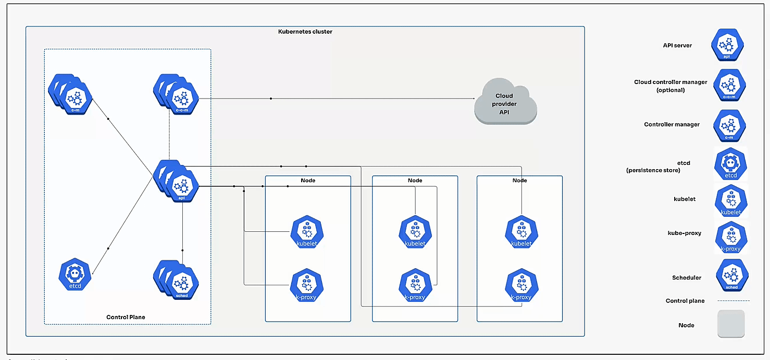
Kubernetes Architecture Diagram
What is Kubernetes?
Kubernetes is an open-source system for automating the deployment, scaling, and management of containerized applications.
It groups containers that make up an application into logical units for easy management and discovery. Kubernetes is a portable, extensible platform that facilitates both declarative configuration and automation.
What is Kubernetes Architecture?
Notes:
https://cloudairy.com/blog/understanding-kubernetes-architecture-diagrams-and-components/
What is Kubernetes Architecture?
Kubernetes, a powerful open-source container orchestration platform, has revolutionized the way organizations manage and deploy containerized applications. At its core, Kubernetes provides a robust framework for automating the deployment, scaling, and management of containerized workloads.
Understanding the Architecture
Kubernetes architecture follows a master-worker model, where the control plane oversees and manages the cluster, while the worker nodes execute the actual containerized applications.
Kubernetes Architecture Components: Control Plane
The control plane is the brain of the Kubernetes cluster, responsible for orchestrating and managing various components. It consists of several key elements:
1. kube-apiserver:
The central communication hub that handles API requests and manages the cluster's state.
Acts as the gateway for users and other components to interact with the cluster.
Validates API requests authenticates and authorizes users, and coordinates processes between the control plane and worker nodes.
Uses etcd to store and retrieve cluster state information.
2. etcd:
A highly available, distributed key-value store that stores critical information about the cluster's configuration and state.
Used by the kube-apiserver to store and retrieve data about pods, services, deployments, and other Kubernetes objects.
Ensures consistency and reliability of the cluster state.
3. kube-scheduler:
Responsible for assigning pods to worker nodes based on resource requirements, constraints, and scheduling policies.
Uses information stored in etcd to make scheduling decisions.
Considers factors like node capacity, affinity rules, and anti-affinity rules.
4. kube-controller-manager:
Manages various controllers that are responsible for specific tasks within the cluster.
Includes controllers for replication sets, deployments, stateful sets, daemon sets, and jobs.
Ensures that the desired state of the cluster is maintained by creating, updating, and deleting pods as needed.
5. cloud-controller-manager (Optional):
Integrates Kubernetes with cloud providers for cloud-specific features.
Provides APIs for interacting with cloud resources, such as virtual machines, load balancers, and storage volumes.
Simplifies the management of Kubernetes clusters in cloud environments.
Kubernetes Architecture Components: Worker Nodes
Worker nodes are the essential components of a Kubernetes cluster where the actual containerized applications are executed. They are responsible for running pods, which are the smallest unit of deployment in Kubernetes and can contain one or more containers.
Key Components of Worker Nodes:
kubelet:
The agent that runs on each worker node and acts as the interface between the node and the control plane.
Responsible for registering the node with the control plane, managing pods on the node, and communicating with the kube-apiserver.
Handles tasks such as creating, starting, stopping, and deleting containers, as well as managing volumes and network interfaces.
kube-proxy:
Responsible for service discovery and load balancing within the cluster.
Creates network rules to route traffic to pods based on service definitions.
Ensures that services are accessible from both inside and outside the cluster.
Container Runtime:
The engine that runs containers on the worker node.
Examples of popular container runtimes include Docker, containerd, and CRI-O.
Responsible for pulling container images, creating and managing containers, and providing resources to containers.
How Worker Nodes Work:
The control plane schedules pods to be executed on worker nodes based on various factors, such as resource requirements and constraints.
The kubelet on the worker node receives the pod specification and creates the necessary containers using the container runtime.
The kube-proxy ensures that services are exposed to the outside world and that traffic is load-balanced across multiple instances of a service.
The worker nodes provide the underlying infrastructure and resources for running containerized applications.
Kubernetes Cluster Add-on Components
Add-on components are optional components that can be added to a Kubernetes cluster to enhance its functionality and meet specific requirements. These components often provide specialized services or features that are not included in the core Kubernetes distribution.
Importance of Add-on Components:
Enhanced functionality: Add-on components can provide additional features and capabilities, such as network management, DNS resolution, and resource monitoring.
Customization: You can choose the add-on components that best suit your specific needs and use cases.
Integration: Many add-on components integrate seamlessly with Kubernetes, making it easy to incorporate them into your cluster.
Popular Add-on Components:
CNI Plugin: A Container Network Interface (CNI) plugin is used to provide network connectivity for containers within a Kubernetes cluster. Popular CNI plugins include Calico, Flannel, and Weave Net.
CoreDNS: A DNS server that provides DNS resolution for services within a Kubernetes cluster.
Metrics Server: A tool that collects and exposes resource usage metrics for Kubernetes clusters, allowing you to monitor and optimize resource allocation.
Web UI: A web-based user interface for managing Kubernetes clusters, providing a more user-friendly way to interact with the platform.
Top Kubernetes Tools
Kubernetes offers a powerful platform for managing containerized applications, but mastering its functionalities requires a robust set of tools. Here's a breakdown of some essential tools categorized by their purpose:
1. Kubernetes CLI Tools:
These command-line tools provide a powerful way to interact with your Kubernetes cluster directly.
kubectl: The swiss army knife of Kubernetes tools. It allows you to perform a wide range of tasks, including managing deployments, pods, services, and namespaces.
Helm: A package manager for Kubernetes that simplifies the deployment and management of applications. Helm charts provide a standardized way to package and install applications in Kubernetes clusters.
Skaffold: A development tool that streamlines the local development and testing of containerized applications. It automates building, pushing, and deploying images to Kubernetes clusters.
Customize: A tool for customizing Kubernetes manifests and deployments. It simplifies applying changes to multiple resources without modifying the original configuration files.
Kubeval: A tool for validating Kubernetes YAML files before deployment. It helps ensure that your configurations are syntactically correct and adhere to best practices.
2. Kubernetes Monitoring Tools:
Effective monitoring is crucial for maintaining healthy and performant Kubernetes clusters. These tools provide insights into resource utilization, application health, and overall cluster performance.
Sematext Monitoring: A comprehensive monitoring solution that offers detailed insights into Kubernetes clusters, including resource usage, application performance, and infrastructure metrics.
Kubernetes Dashboard: A simple web-based UI for viewing and managing your Kubernetes cluster. It provides an overview of resources, deployments, and pod health.
Prometheus: A popular open-source monitoring system that collects and stores metrics from containerized applications and Kubernetes resources.
Grafana: A visualization tool that allows you to create custom dashboards for visualizing metrics collected by Prometheus and other monitoring tools.
Jaeger: A distributed tracing platform that helps you understand the flow of requests through your microservices applications. Jaeger can be integrated with Kubernetes to monitor the performance and health of your containerized services.
3. Kubernetes Security Tools:
Security is paramount for any containerized environment. These tools help you harden your Kubernetes cluster and identify potential security vulnerabilities.
Open Policy Agent (OPA): A powerful policy engine that allows you to enforce security policies at various levels within your Kubernetes cluster.
KubeLinter: A tool that analyzes Kubernetes YAML files for security best practices and potential vulnerabilities.
Kube-bench: A tool that performs security audits of your Kubernetes cluster configuration. It identifies potential security risks and suggests remediation steps.
Kube-hunter: A security tool that scans for vulnerabilities in Kubernetes clusters by identifying unauthorized deployments, privileged containers, and misconfigurations.
Terrascan: A tool used for infrastructure security scanning. It can be integrated with Kubernetes to scan your cluster configuration for security risks.
4. Kubernetes Deployment Tools:
These tools automate the build, test, and deployment process for your containerized applications, enabling you to streamline your CI/CD (continuous integration/continuous delivery) pipelines.
Jenkins: A popular open-source CI/CD tool that can be used to automate the build, test, and deployment of containerized applications to Kubernetes clusters.
Spinnaker: A powerful CI/CD platform that offers continuous delivery features for deploying containerized applications to Kubernetes.
Fluxcd.io: A GitOps tool that uses Git as the source of truth for managing deployments in Kubernetes. It automates the deployment of applications based on changes made to Git repositories.
Choosing the Right Tools
The selection of the best tools depends on your specific needs and use case. Consider factors like the size and complexity of your cluster, your monitoring and security requirements, and your preferred CI/CD pipeline structure. By leveraging the right combination of tools, you can effectively manage your Kubernetes environment, optimize performance, and ensure the reliability and security of your containerized applications.
Kubernetes Architecture Best Practices
Kubernetes, as a powerful container orchestration platform, provides numerous features and functionalities to manage containerized applications effectively. To optimize your Kubernetes deployments and ensure maximum performance, reliability, and security, it's essential to adhere to best practices.
1. Utilizing Namespaces:
Logical Isolation: Namespaces offer a way to logically divide your cluster into distinct environments or projects.
Resource Management: They help manage resources more efficiently by isolating different teams or applications.
Security: Namespaces can be used to implement role-based access control (RBAC) and restrict access to specific resources.
2. Implementing Readiness and Liveness Probes:
Health Checks: Readiness probes check if a pod is ready to receive traffic, while liveness probes ensure the container is still running and healthy.
Automatic Restart: Kubernetes can automatically restart pods that fail liveness probes or are not ready to receive traffic.
3. Setting Resource Requests and Limits:
Resource Allocation: Define the minimum and maximum resources (CPU and memory) that a pod requires.
Preventing Overutilization: Setting limits helps prevent pods from consuming excessive resources and impacting other applications.
Quality of Service: Guaranteeing a certain level of performance for critical applications.
4. Leveraging High-Level Deployment Objects:
Abstractions: Use higher-level deployment objects like Deployments, ReplicaSets, StatefulSets, and DaemonSets to simplify application management.
Declarative Configuration: Describe the desired state of your application, and Kubernetes will automatically reconcile the actual state to match the desired one.
Rolling Updates: Easily update applications without downtime using features like rolling updates.
5. Distributing Workloads Across Multiple Nodes:
Availability: Spread pods across multiple nodes to improve fault tolerance and availability.
Load Balancing: Distribute traffic evenly across pods to prevent overloading individual nodes.
Resource Optimization: Ensure efficient utilization of resources across the cluster.
6. Implementing Role-Based Access Control (RBAC):
Security: Restrict access to resources based on user roles and permissions.
Granular Control: Grant specific permissions to different users or groups, preventing unauthorized access.
Compliance: Ensure compliance with security regulations and best practices.
7. Considering Cloud Services for External Hosting:
Managed Kubernetes: Utilize cloud-managed Kubernetes services like AWS EKS, Azure AKS, or Google Kubernetes Engine for simplified management and scalability.
Additional Features: Benefit from built-in features such as load balancing, auto-scaling, and integrated monitoring tools.
8. Regularly Updating to the Latest Version:
Security Patches: Stay up-to-date with the latest Kubernetes versions to benefit from security patches and bug fixes.
New Features: Access new features and enhancements introduced in newer versions.
Improved Performance: Enjoy performance improvements and optimizations.
9. Monitoring Cluster Resources and Auditing Policy Logs:
Troubleshooting: Monitor resource usage, identify bottlenecks, and troubleshoot performance issues.
Security: Audit policy logs to detect and address security threats.
Optimization: Make data-driven decisions to improve cluster efficiency and resource allocation.
10. Employing Version Control for Configuration Files:
Collaboration: Use version control systems like Git to manage Kubernetes configuration files collaboratively.
Tracking Changes: Easily track changes, revert to previous versions, and collaborate with team members.
Automation: Integrate version control with CI/CD pipelines for automated deployments.
By following these best practices, you can optimize your Kubernetes deployments, improve performance, enhance security, and ensure the reliability of your containerized applications.
Source: Azure
Key Takeaways
Introduction:
Kubernetes is a powerful open-source platform for managing containerized applications.
Understanding its architecture is crucial for efficient deployments.
Architecture:
Master-worker model: Control plane manages the cluster, worker nodes execute applications.
Control Plane Components:
kube-apiserver: Central communication hub for API requests and cluster state management.
etcd: Distributed key-value store that stores cluster state information.
kube-scheduler: Assigns pods to worker nodes based on resource requirements and constraints.
kube-controller-manager: Manages controllers for replicating pods and ensuring desired cluster state.
cloud-controller-manager (Optional): Integrates Kubernetes with cloud providers.
Worker Node Components:
kubelet: Manages pods on the node and communicates with the control plane.
kube-proxy: Handles service discovery and load balancing within the cluster.
Container Runtime: Engine that runs containers on the worker node (e.g., Docker, containerd).
Optimizing Deployments:
Utilize namespaces for isolation and resource management.
Implement readiness and liveness probes for pod health checks.
Set resource requests and limits for optimal resource allocation.
Leverage high-level deployment objects for simplified application management.
Distribute workloads across multiple nodes for improved availability and load balancing.
Implement RBAC for enhanced security and access control.
Consider cloud services for external hosting and additional features.
Regularly update Kubernetes for security patches, new features, and performance improvements.
Monitor cluster resources and audit policy logs for troubleshooting and optimization.
Employ version control for configuration files for collaboration and automation.
Benefits of Kubernetes Architecture
Scalability: Kubernetes can easily scale applications up or down based on demand, ensuring optimal resource utilization.
High Availability: The distributed nature of Kubernetes ensures that applications remain available even if individual nodes fail.
Portability: Kubernetes applications can be easily moved between different environments (e.g., on-premises, cloud).
Efficiency: Kubernetes automates many of the complex tasks involved in managing containerized applications, improving efficiency and reducing operational overhead.
Flexibility: Kubernetes provides a flexible and customizable platform that can be adapted to various use cases and requirements.
Source: Azure

Slide 19
Kubernetes Architecture Diagram
10. Employing Version Control for Configuration Files:
Notes:
https://cloudairy.com/blog/understanding-kubernetes-architecture-diagrams-and-components/#section-6
10. Employing Version Control for Configuration Files:
Collaboration: Use version control systems like Git to manage Kubernetes configuration files collaboratively.
Tracking Changes: Easily track changes, revert to previous versions, and collaborate with team members.
Automation: Integrate version control with CI/CD pipelines for automated deployments.
By following these best practices, you can optimize your Kubernetes deployments, improve performance, enhance security, and ensure the reliability of your containerized applications.

Slide 20
Kubernetes Architecture Diagram
Notes:
https://cloudairy.com/blog/understanding-kubernetes-architecture-diagrams-and-components/#section-6
Key Takeaways
Introduction:
Kubernetes is a powerful open-source platform for managing containerized applications.
Understanding its architecture is crucial for efficient deployments.
Architecture:
Master-worker model: Control plane manages the cluster, worker nodes execute applications.
Control Plane Components:
kube-apiserver: Central communication hub for API requests and cluster state management.
etcd: Distributed key-value store that stores cluster state information.
kube-scheduler: Assigns pods to worker nodes based on resource requirements and constraints.
kube-controller-manager: Manages controllers for replicating pods and ensuring desired cluster state.
cloud-controller-manager (Optional): Integrates Kubernetes with cloud providers.
Worker Node Components:
kubelet: Manages pods on the node and communicates with the control plane.
kube-proxy: Handles service discovery and load balancing within the cluster.
Container Runtime: Engine that runs containers on the worker node (e.g., Docker, containerd).
Optimizing Deployments:
Utilize namespaces for isolation and resource management.
Implement readiness and liveness probes for pod health checks.
Set resource requests and limits for optimal resource allocation.
Leverage high-level deployment objects for simplified application management.
Distribute workloads across multiple nodes for improved availability and load balancing.
Implement RBAC for enhanced security and access control.
Consider cloud services for external hosting and additional features.
Regularly update Kubernetes for security patches, new features, and performance improvements.
Monitor cluster resources and audit policy logs for troubleshooting and optimization.
Employ version control for configuration files for collaboration and automation.
Benefits of Kubernetes Architecture
Scalability: Kubernetes can easily scale applications up or down based on demand, ensuring optimal resource utilization.
High Availability: The distributed nature of Kubernetes ensures that applications remain available even if individual nodes fail.
Portability: Kubernetes applications can be easily moved between different environments (e.g., on-premises, cloud).
Efficiency: Kubernetes automates many of the complex tasks involved in managing containerized applications, improving efficiency and reducing operational overhead.
Flexibility: Kubernetes provides a flexible and customizable platform that can be adapted to various use cases and requirements.
Source: Azure

Slide 21
Kubernetes Architecture and
Container Deployment
Notes:
https://www.ais.com/an-overview-of-kubernetes-architecture-and-container-deployment/

Slide 22
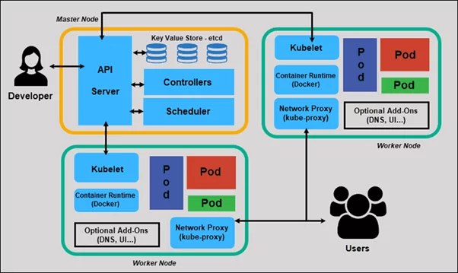
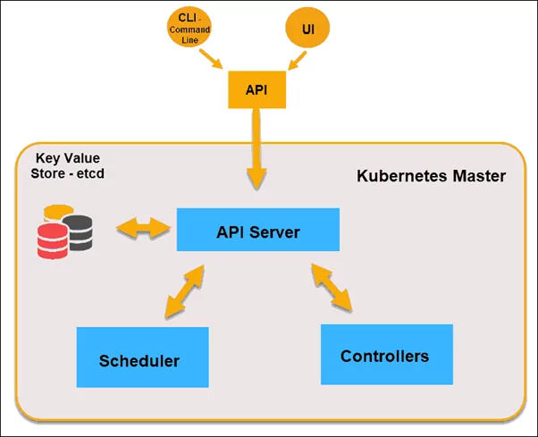
Kubernetes Architecture and Container Deployment
API servers perform
Master nodes
Key Value Store : distributed Key-Value Store used to hold and manage the critical information that distributed systems need to keep running. The Key-Value Store, also called etcd, is a database Kubernetes uses to back up all cluster data. It stores the entire configuration and state of the cluster.
Controller is to obtain the desired state from the API Server. It checks the current state of the nodes it is tasked to control, and determines if there are any differences, and resolves them if any.
Scheduler’s main job is to watch for new requests coming from the API Server and assign them to healthy nodes. It ranks the quality of the nodes and deploys pods to the best-suited node.
Worker nodes listen to the API Server for new work assignments; they execute the work assignments and then report the results to the Kubernetes Master node.
Notes:
https://www.ais.com/an-overview-of-kubernetes-architecture-and-container-deployment/

Slide 23
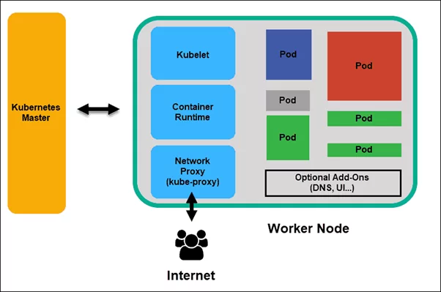
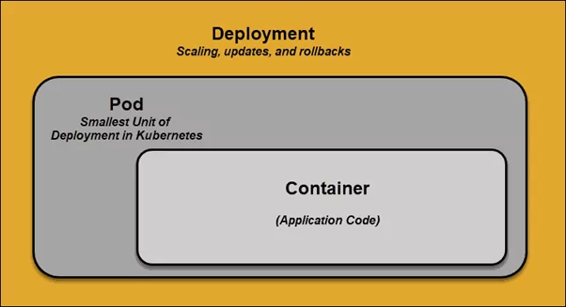
Kubernetes Architecture and Container Deployment
Kubelet, The kubelet runs on every node in the cluster. It is the principal Kubernetes agent. By installing kubelet, the node’s CPU, RAM, and storage become part of the broader cluster. It watches for tasks sent from the API Server, executes the task, and reports back to the Master.
Container Runtime, The container runtime pulls images from a container image registry and starts and stops containers. A 3rd party software or plugin, such as Docker, usually performs this function.
Kube-proxy, The kube-proxy makes sure that each node gets its IP address.
Pod, A pod is the smallest element of scheduling in Kubernetes. Without it, a container cannot be part of a cluster.
Notes:
https://www.ais.com/an-overview-of-kubernetes-architecture-and-container-deployment/

Slide 24
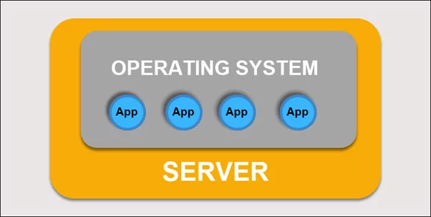
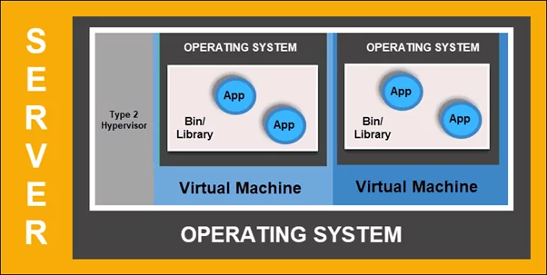
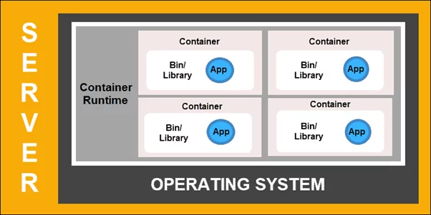
Container Deployment
Kubernetes Services
Traditional Deployment
Virtualized Deployment
Container Deployment

Slide 25
Thx

Slide 26
Mengatur Sumber Daya Komputasi untuk Container
Jenis sumber daya
CPU dan memori masing-masing merupakan jenis sumber daya (resource type). Sebuah jenis sumber daya memiliki satuan dasar. CPU ditentukan dalam satuan jumlah core, dan memori ditentukan dalam satuan bytes. Jika kamu menggunakan Kubernetes v1.14 keatas, kamu dapat menentukan sumber daya huge page. Huge page adalah fitur khusus Linux di mana kernel Node mengalokasikan blok-blok memori yang jauh lebih besar daripada ukuran page bawaannya.
Sebagai contoh, pada sebuah sistem di mana ukuran page bawaannya adalah 4KiB, kamu dapat menentukan sebuah limit, hugepages-2Mi: 80Mi. Jika kontainer mencoba mengalokasikan lebih dari 40 huge page berukuran 20MiB (total 80MiB), maka alokasi tersebut akan gagal.
Saat kamu membuat spesifikasi sebuah Pod, kamu dapat secara opsional menentukan seberapa banyak CPU dan memori (RAM) yang dibutuhkan oleh setiap Container. Saat Container-Container menentukan request (permintaan) sumber daya, scheduler dapat membuat keputusan yang lebih baik mengenai Node mana yang akan dipilih untuk menaruh Pod-Pod. Dan saat limit (batas) sumber daya Container-Container telah ditentukan, maka kemungkinan rebutan sumber daya pada sebuah Node dapat dihindari. Untuk informasi lebih lanjut mengenai perbedaan request dan limit
https://github.com/kubernetes/kubernetes
Notes:
https://kubernetes.io/id/docs/concepts/configuration/manage-compute-resources-container/
https://docs.docker.com/desktop/settings-and-maintenance/settings/#advanced

Slide 27
CPU
Request dan Limit Sumber daya dari Pod dan ContainerLimit dan request untuk sumber daya CPU diukur dalam satuan cpu. Satu cpu, dalam Kubernetes, adalah sama dengan:
1 vCPU AWS
1 Core GCP
1 vCore Azure
1 vCPU IBM
1 Hyperthread pada sebuah prosesor Intel bare-metal dengan Hyperthreading
Setiap Container dari sebuah Pod dapat menentukan satu atau lebih dari hal-hal berikut:
spec.containers[].resources.limits.cpu
spec.containers[].resources.limits.memory
spec.containers[].resources.limits.hugepages-<size>
spec.containers[].resources.requests.cpu
spec.containers[].resources.requests.memory
spec.containers[].resources.requests.hugepages-<size>
Request dalam bentuk pecahan diizinkan. Sebuah Container dengan spec.containers[].resources.requests.cpu bernilai 0.5 dijamin mendapat setengah CPU dibandingkan dengan yang meminta 1 CPU. Ekspresi nilai 0.1 ekuivalen dengan ekspresi nilai 100m, yang dapat dibaca sebagai "seratus milicpu". Beberapa orang juga membacanya dengan "seratus milicore", dan keduanya ini dimengerti sebagai hal yang sama. Sebuah request dengan angka di belakang koma, seperti 0.1 dikonversi menjadi 100m oleh API, dan presisi yang lebih kecil lagi dari 1m tidak dibolehkan. Untuk alasan ini, bentuk 100m mungkin lebih disukai.
CPU juga selalu diminta dalam jumlah yang mutlak, tidak sebagai jumlah yang relatif; 0.1 adalah jumlah CPU yang sama pada sebuah mesin single-core, dual-core, atau 48-core
Notes:
https://kubernetes.io/id/docs/concepts/configuration/manage-compute-resources-container/
https://learn.microsoft.com/id-id/visualstudio/docker/tutorials/tutorial-persist-data-layer-docker-app-with-vscode

Slide 28
apiVersion: v1
kind: Pod
metadata:
name: frontend
spec:
containers:
- name: db
image: mysql
env:
- name: MYSQL_ROOT_PASSWORD
value: "password"
resources:
requests:
memory: "64Mi“
cpu: "250m"
limits:
memory: "128Mi"
cpu: "500m“
- name: wp
image: wordpress
resources:
requests:
memory: "64Mi"
cpu: "250m"
limits:
memory: "128Mi“
cpu: "500m"
Memory
Limit dan request untuk memory diukur dalam satuan bytes. Kamu dapat mengekspresikan memori sebagai plain integer atau sebagai sebuah fixed-point integer menggunakan satu dari sufiks-sufiks berikut: E, P, T, G, M, K. Kamu juga dapat menggunakan bentuk pangkat dua ekuivalennya: Ei, Pi, Ti, Gi, Mi, Ki. Sebagai contoh, nilai-nilai berikut kurang lebih sama:
128974848, 129e6, 129M, 123Mi
Berikut sebuah contoh. Pod berikut memiliki dua Container. Setiap Container memiliki request 0.25 cpu dan 64MiB (226 bytes) memori. Setiap Container memiliki limit 0.5 cpu dan 128MiB memori. Kamu dapat berkata bahwa Pod tersebut memiliki request 0.5 cpu dan 128MiB memori, dan memiliki limit 1 cpu dan 265MiB memori.
Notes:
https://kubernetes.io/id/docs/concepts/configuration/manage-compute-resources-container/
https://learn.microsoft.com/id-id/visualstudio/docker/tutorials/tutorial-persist-data-layer-docker-app-with-vscode
https://learn.microsoft.com/id-id/visualstudio/docker/tutorials/tutorial-persist-data-layer-docker-app-with-vscode

Slide 29
How to assign more memory to docker container
Docker Start
CONTAINER CPU % MEM USAGE / LIMIT MEM % NET I/O BLOCK I/O PIDS
ba57d6c9e9d2 0.22% 145.6 MiB / 1.952 GiB 7.29% 508 B / 508 B 0 B / 6.91 MB 68
setting memory explicitly like
docker run -d --memory=10g --memory-swap=-1 -e MYSQL_PASSWORD=password -p 3307:3306 -p 8081:8080 aallam/tomcat-mysql
Using Docker update
update Update configuration of one or more containers:
docker update ttdb --memory=1G --memory-swap=1G
Additional Options
docker container update, docker update
Options:
--blkio-weight uint16 Block IO (relative weight), between 10 and 1000, or 0 to disable (default 0)
--cpu-period int Limit CPU CFS (Completely Fair Scheduler) period
--cpu-quota int Limit CPU CFS (Completely Fair Scheduler) quota
--cpu-rt-period int Limit the CPU real-time period in microseconds
--cpu-rt-runtime int Limit the CPU real-time runtime in microseconds
-c, --cpu-shares int CPU shares (relative weight)
--cpus decimal Number of CPUs
--cpuset-cpus string CPUs in which to allow execution (0-3, 0,1)
--cpuset-mems string MEMs in which to allow execution (0-3, 0,1)
-m, --memory bytes Memory limit
--memory-reservation bytes Memory soft limit
--memory-swap bytes Swap limit equal to memory plus swap: -1 to enable unlimited swap
--pids-limit int Tune container pids limit (set -1 for unlimited)
--restart string Restart policy to apply when a container exits
Notes:
https://stackoverflow.com/questions/44533319/how-to-assign-more-memory-to-docker-container

